Slide 1
Warm-Up – 8/30 – 10 minutes
Utilizing your notes and past knowledge answer the following questions:
During development of the airplane, early pioneers struggled with…?
Who identified the forces of lift, drag, and thrust and built the 1st successful full-sized, manned glider?
Who was known as the “Father of Modern Aviation and is credited with over 2,000 glider flights?
This aviation pioneer was known for his study of aviation history and collection and distribution of aviation information?
Who is credited with making the first “two” attempts launching an aircraft off a barge via a catapult?

Slide 2
Questions / Comments

Slide 3
Warm-Up – 8/30 – 10 minutes
Utilizing your notes and past knowledge answer the following questions:
During development of the airplane, early pioneers struggled with…?
Who identified the forces of lift, drag, and thrust and built the 1st successful full-sized, manned glider?
Who was known as the “Father of Modern Aviation and is credited with over 2,000 glider flights?
This aviation pioneer was known for his study of aviation history and collection and distribution of aviation information?
Who is credited with making the first “two” attempts launching an aircraft off a barge via a catapult?

Slide 4
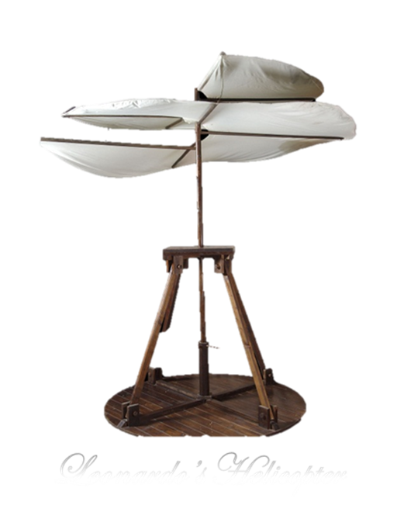
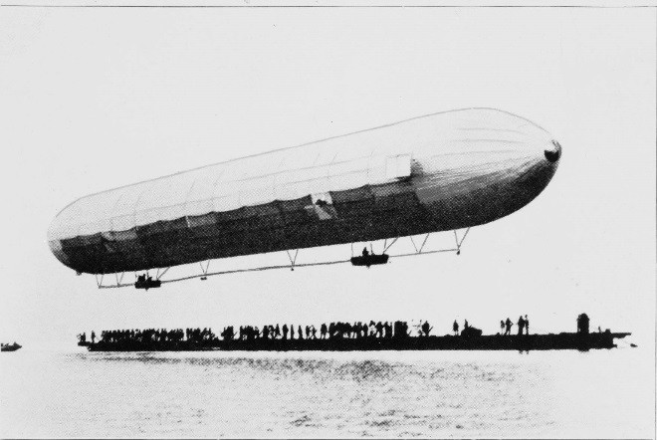
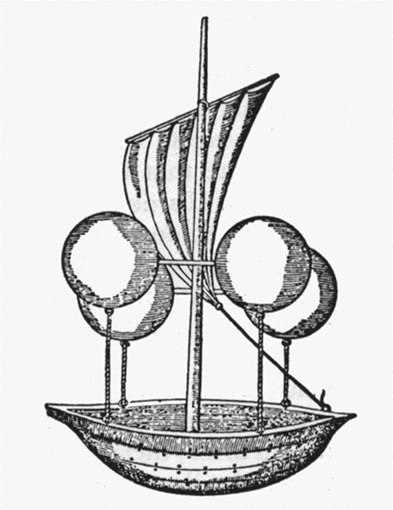
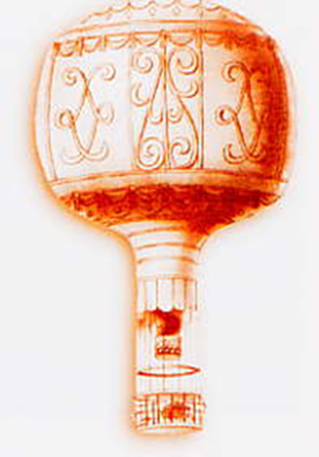
Developing the Airplane
Aviation Pioneers struggled with:
developing lift
sustaining lift
and controlling aircraft

Slide 5
Warm-Up – 8/30 – 10 minutes
Utilizing your notes and past knowledge answer the following questions:
During development of the airplane, early pioneers struggled with…?
Who identified the forces of lift, drag, and thrust and built the 1st successful full-sized, manned glider?
Who was known as the “Father of Modern Aviation and is credited with over 2,000 glider flights?
This aviation pioneer was known for his study of aviation history and collection and distribution of aviation information?
Who is credited with making the first “two” attempts launching an aircraft off a barge via a catapult?

Slide 6
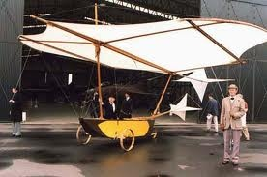
Developing the Airplane
Sir George Cayley was the 1st 19th century airplane pioneer
Built and flew small model gliders
Laid foundation for modern aeronautics with published account of making a surface support a given weight by the application of power to the resistance of air
He identified the forces of lift, drag, and thrust
Built 1st successful full-sized, manned glider

Slide 7
Warm-Up – 8/30 – 10 minutes
Utilizing your notes and past knowledge answer the following questions:
During development of the airplane, early pioneers struggled with…?
Who identified the forces of lift, drag, and thrust and built the 1st successful full-sized, manned glider?
Who was known as the “Father of Modern Aviation and is credited with over 2,000 glider flights?
This aviation pioneer was known for his study of aviation history and collection and distribution of aviation information?
Who is credited with making the first “two” attempts launching an aircraft off a barge via a catapult?

Slide 8
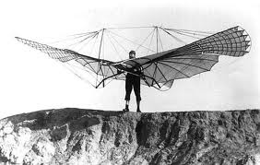
Developing the Airplane
Otto Lilienthal – Father of Modern Aviation
He built single-winged and two-winged gliders
1891-1896, he made over 2,000 glides some over 700 ft
Built an engine to link the wingtips
Built a pilot control system
Wrote a book on aviation and spurred interest around the world

Slide 9
Warm-Up – 8/30 – 10 minutes
Utilizing your notes and past knowledge answer the following questions:
During development of the airplane, early pioneers struggled with…?
Who identified the forces of lift, drag, and thrust and built the 1st successful full-sized, manned glider?
Who was known as the “Father of Modern Aviation and is credited with over 2,000 glider flights?
This aviation pioneer was known for his study of aviation history and collection and distribution of aviation information?
Who is credited with making the first “two” attempts launching an aircraft off a barge via a catapult?

Slide 10
Developing the Airplane
Octave Chanute
Read Lilienthal’s works and improved upon them
Designed gliders but was too old to fly them
Known for his study of aviation history and collection and distribution of aviation information

Slide 11
Warm-Up – 8/30 – 10 minutes
Utilizing your notes and past knowledge answer the following questions:
During development of the airplane, early pioneers struggled with…?
Who identified the forces of lift, drag, and thrust and built the 1st successful full-sized, manned glider?
Who was known as the “Father of Modern Aviation and is credited with over 2,000 glider flights?
This aviation pioneer was known for his study of aviation history and collection and distribution of aviation information?
Who is credited with making the first “two” attempts launching an aircraft off a barge via a catapult?

Slide 12
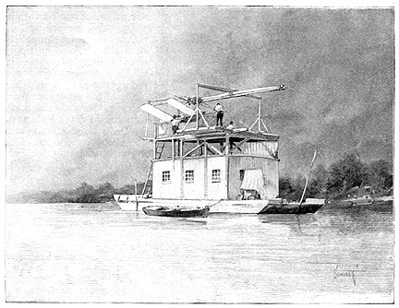
Developing the Airplane
Samuel Pierpont Langley attempted to add power to a glider
1903, the Aerodrome launched by a catapult from a barge anchored in the Potomac River
It fell into the river.
Same thing happened on the next attempt two months later
Both attempts widely covered by the press – the U.S. government dropped its support and Langley gave up project

Slide 13
Questions / Comments

Slide 14
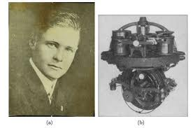
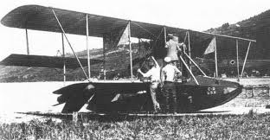
THIS DAY IN AVIATION
August 30
1913 — American inventor Lawrence B. Sperry successfully demonstrates the first gyroscopic automatic stabilizing device for powered airplanes when Lt. Patrick N. L. Bellinger pilots a United States Navy flying boat designated “C-2” and relinquishes full control to the autopilot.

Slide 15
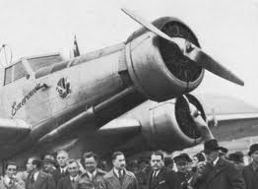
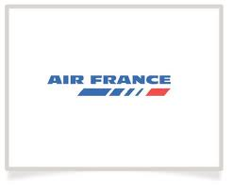
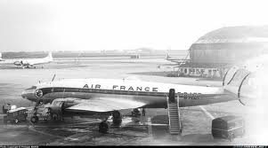
THIS DAY IN AVIATION
August 30
1933 -Air France, France's national airline, is formed.

Slide 16
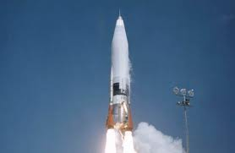
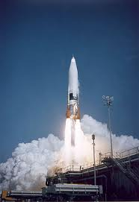
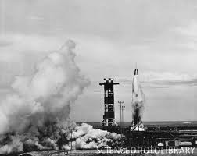
THIS DAY IN AVIATION
August 30
1960 — The USAF's first “Atlas” intercontinental ballistic missile (ICBM) squadron became fully operational.

Slide 17
Questions / Comments

Slide 18
August 2017
Sunday | Monday | Tuesday | Wednesday | Thursday | Friday | Saturday
 |  | 1 | 2 | 3 | 4 | 5
6 | 7 | 8 | 9 | 10 | 11 | 12
13 | 14 | 15 | 16 | 17 Welcome to Aviation | 18 Flightline Friday | 19
20 | 21 NO SCHOOL | 22 Parts of an Aircraft Forces of Flight Syllabus Due | 23 Flight Control Surfaces | 24 Aircraft Review | 25 Flight Line Friday Quiz | 26
27 | 28 Chapter 1 Intro to Aviation | 29 Chapter 1 Intro to Aviation | 30 Chapter 1 Intro to Aviation | 31 Chapter 1 Intro to Aviation | 1 Flightline Friday Test | 2
3 | 4 HOLIDAY | 5 | 6

Slide 19
Questions / Comments

Slide 20
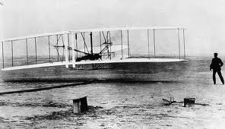
Wright
Brothers
Story

Slide 21
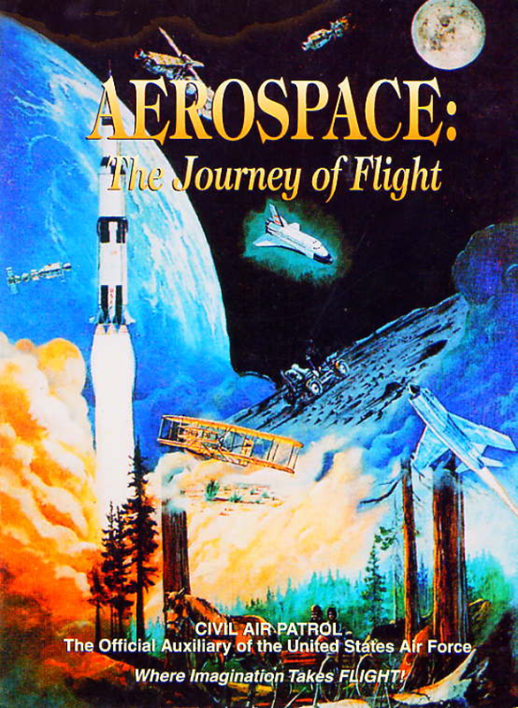
Chapter 1
Introduction to Air Power

Slide 22
Today’s Mission Requirements
Mission:
Identify the significant contributions that advanced air and space power.
Identify the individuals with the contributions they made to developing the airplane.
EQ:
Describe some of the innovations that led to advances in air and space power.

Slide 23
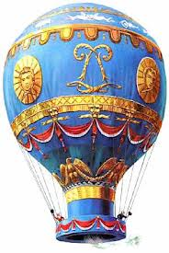
Developing the Airplane
Initial pioneers of aviation struggled with the forces of flight
How to develop Lift to get them in air
How to sustain the lift
How to develop a way to control the aircraft

Slide 24
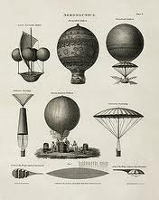
Developing the Airplane
Balloonists solved the first 2 problems by building aircraft lighter than air
(Created lift)
Kept aloft by dumping ballast or maintaining fire to heat the air
(Sustained lift)
So the issue came down to control
An Airplane doesn’t have a balloon to keep aloft – early pioneers had all three problems

Slide 25
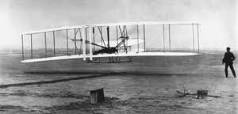
Developing the Airplane
The Wright Brothers – Orville and Wilbur
Approach to flight was to first
develop an aircraft that would fly
Aircraft that could be controlled in flight
And then to add a power plant

Slide 26
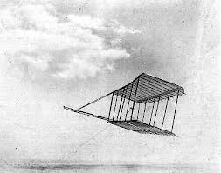
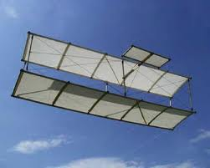
Developing the Airplane
Observed birds and noticed they maneuvered in flight by twisting their wings
Developed the wing-warping technique
Tested on kite – then glider

Slide 27
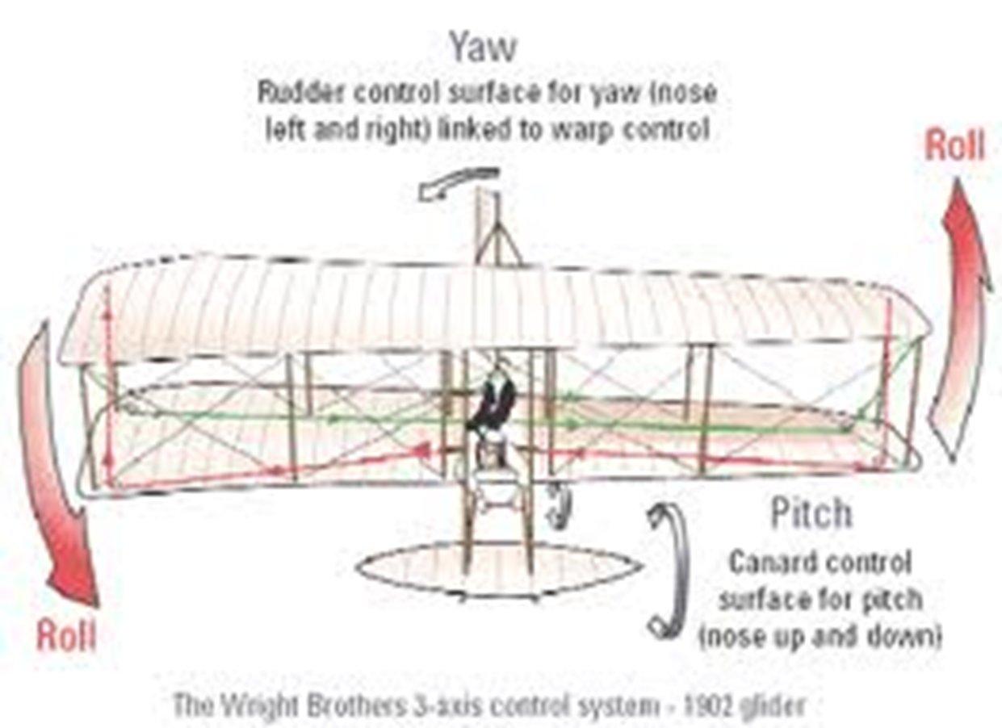

Slide 28
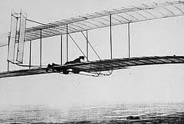
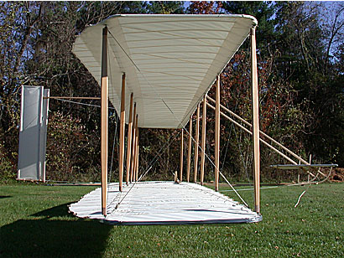
Developing the Airplane
Contacted Weather Bureau for location of sustained wind
Kill Devil Hills, NC
By October 1902, had over 1,000 successful glider flights – had solved all of the major control problems –
just needed a suitable power plant

Slide 29
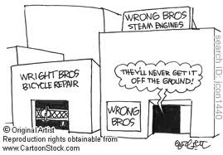

Slide 30
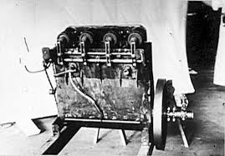
Developing the Airplane
They enlisted mechanic Charlie Taylor who built a water cooled 12 hp engine
Connected via bicycle chains to the sprockets which turned the propellers

Slide 31
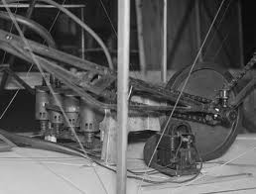

Slide 32
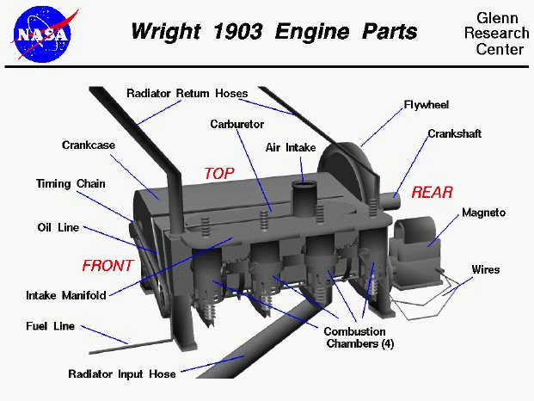

Slide 33
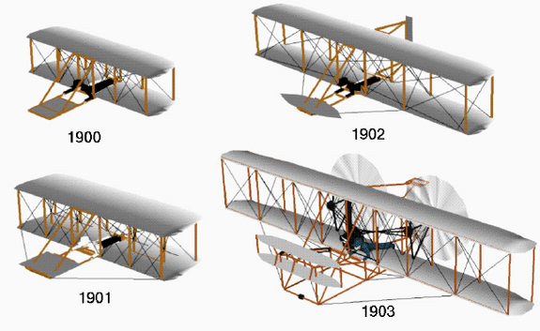
Wright Flyers

Slide 34
Questions / Comments

Slide 35
SAFETY FIRST.
SAFETY ALWAYS.

Slide 36
Safety Rules – Safety Monitor Brief
Must Use Safety Glasses
Use of Cutting tools is Dangerous – AT ALL TIMES
Must Use Cutting Mats
Extended breathing of adhesives and paint fumes can be dangerous
All Areas will remain clean and organized
Plane Captains will insure All Areas will be cleaned and all items put back in proper locations 10minutes prior to class ending
Class safety monitor will insure areas are clean and safe at all times

Slide 37
Questions / Comments

Slide 38
Today’s Mission Requirements
Mission:
Identify the significant contributions that advanced air and space power.
Identify the individuals with the contributions they made to developing the airplane.
EQ:
Describe some of the innovations that led to advances in air and space power.

Slide 39
Developing the Airplane
The Wright Brothers – Orville and Wilbur
Approach to flight:
was to first develop an aircraft that would fly
Aircraft that could be controlled in flight
And then to add a power plant

Slide 40
Developing the Airplane
Observed birds and noticed they maneuvered in flight by twisting their wings
Developed the wing-warping technique
Tested on kite – then glider

Slide 41
Developing the Airplane
Contacted Weather Bureau for location of sustained wind
Kill Devil Hills, NC
By October 1902, had over 1,000 successful glider flights – had solved all of the major control problems –
just needed a suitable power plant

Slide 42
Today’s Mission Requirements
Mission:
Identify the significant contributions that advanced air and space power.
Identify the individuals with the contributions they made to developing the airplane.
EQ:
Describe some of the innovations that led to advances in air and space power.

Slide 43
Developing the Airplane
They enlisted mechanic Charlie Taylor who built a water cooled 12 hp engine
Connected via bicycle chains to the sprockets which turned the propellers

Slide 44
Lesson Closure - 3 – 2 - 1
3. List 3 things you learned today.
2. List 2 things you have questions about today’s lesson.
1. Create (1) quiz question with answer about today’s lesson.

Slide 45
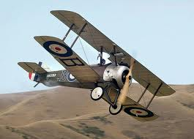
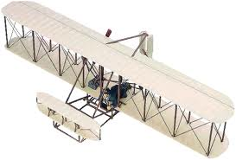
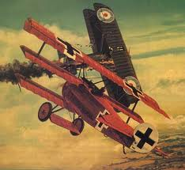

Slide 46
SAFETY FIRST.
SAFETY ALWAYS.

Slide 47
Safety Rules – Safety Monitor Brief
Must Use Safety Glasses
Use of Cutting tools is Dangerous – AT ALL TIMES
Must Use Cutting Mats
Extended breathing of adhesives and paint fumes can be dangerous
All Areas will remain clean and organized
Plane Captains will insure All Areas will be cleaned and all items put back in proper locations 10minutes prior to class ending
Class safety monitor will insure areas are clean and safe at all times

Slide 48
Questions / Comments

Slide 49
Model Building Grading Rubic
Each Group MUST follow all directions
STOP! - If you are unsure
SAFETY at ALL Times
Accuracy and Authenticity will be judged
Each Group Member is responsible to produce a 2 page paper on the model.
Aircraft Specifications
Aircraft contribution to Aviation development
Significant Aviation Pioneers associated with aircraft (pilots, inventors etc.)
The Group will provide a Presentation on the model.
5to 7 slides (Title slide; Body; Summary Slide)

Slide 50
Questions / Comments

Slide 51
Wright
Brothers
Story

